Slide 1
CS 316: Introduction to Deep Learning
Numerical Stability and Initialisation
Week 7
Dr Abdul Samad

Slide 2
Lecture Outline
Vanishing and Exploding Gradients
Breaking Symmetry
Xavier initialization

Slide 3

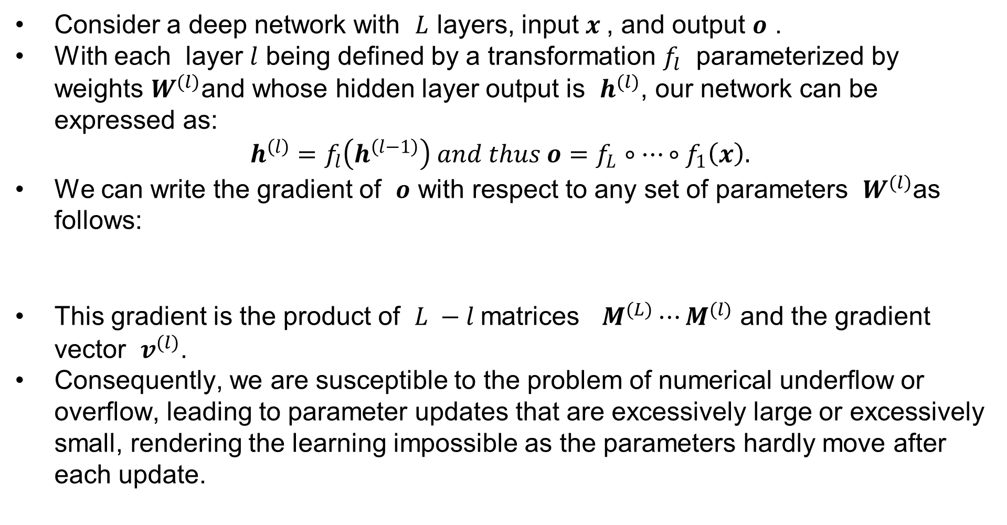
Vanishing and Exploding Gradients
Consider a deep network with $L$ layers, input $x$, and output $o$ .
With each layer $l$ being defined by a transformation $f_{l}$ parameterized by weights $W^{(l)}$and whose hidden layer output is $h^{(l)}$, our network can be expressed as:
$h^{\left(l\right)}=f_{l}\left(h^{\left(l−1\right)}\right) and thus o=f_{L}∘⋯∘f_{1}\left(x\right).$
We can write the gradient of $o$ with respect to any set of parameters $W^{(l)}$as follows:
This gradient is the product of $L −l$matrices $M^{(L)}⋯M^{(l)}$ and the gradient vector $v^{(l)}$.
Consequently, we are susceptible to the problem of numerical underflow or overflow, leading to parameter updates that are excessively large or excessively small, rendering the learning impossible as the parameters hardly move after each update.

Slide 4
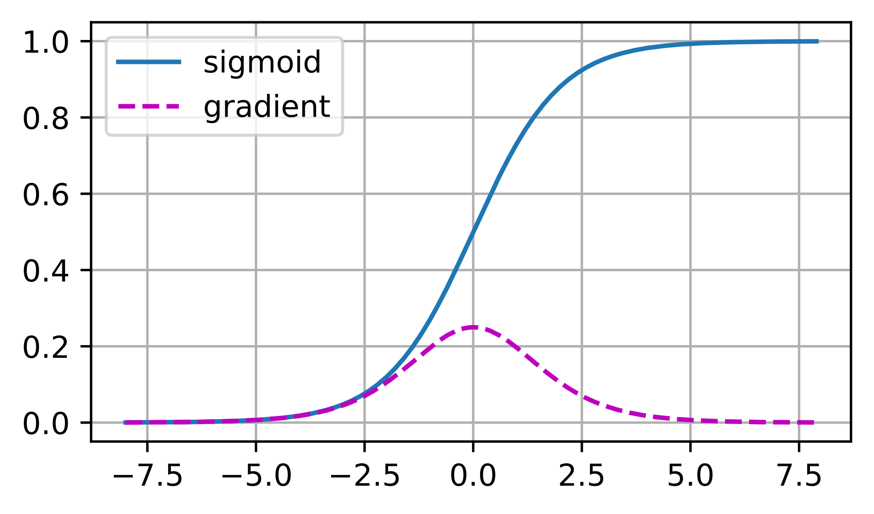
Vanishing Gradients
The choice of the activation function that is applied following each layer's linear operations is a common cause of the vanishing gradients.
In the graph above, we can see that the sigmoid’s gradient vanishes both when its inputs are large and when they are small.
Moreover, when backpropagating through many layers, unless the inputs to many of the sigmoid’s are close to zero, the overall product may vanish. So unless we are careful, the gradient will likely be cut off at some layer.
Figure taken from Vanishing Gradients

Slide 5
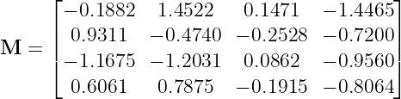
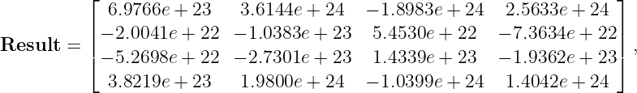
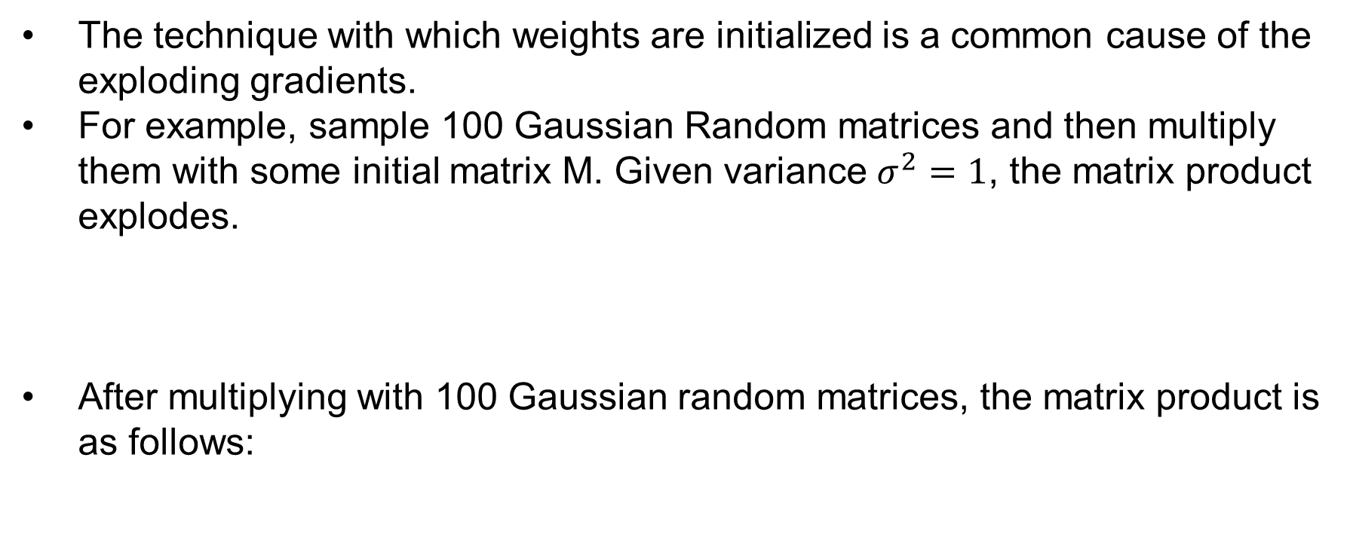
Exploding Gradients
The technique with which weights are initialized is a common cause of the exploding gradients.
For example, sample 100 Gaussian Random matrices and then multiply them with some initial matrix M. Given variance $σ^{2}=1$, the matrix product explodes.
After multiplying with 100 Gaussian random matrices, the matrix product is as follows:

Slide 6
Breaking Symmetry
Another problem in neural network design is the inherent symmetry in their parameterization.
For example, consider the MLP a with one hidden layer containing two hidden units.
In this case, we could permute the weights of the first layer and likewise permute the weights of the output layer to obtain the same function. In other words, we have permutation symmetry among the hidden units of each layer.
In addition, if we initialized all the parameters of the hidden layer with a constant value. During the forward propagation, each hidden unit would the same value and during backward propagation, each hidden unit would have the same gradient. As a result, each unit will have the same value and the layer would behave as if it only had a single unit.

Slide 7
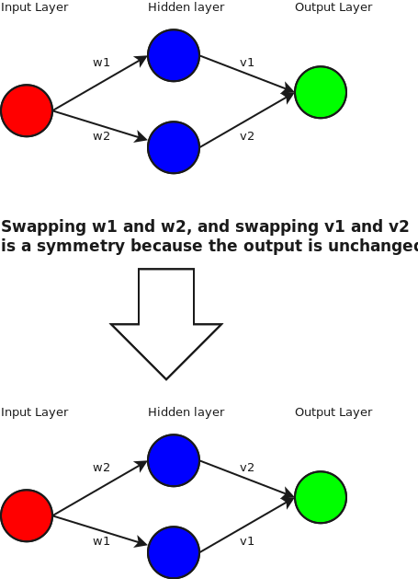
Breaking Symmetry
Figure taken from Permutation Symmetry

Slide 8
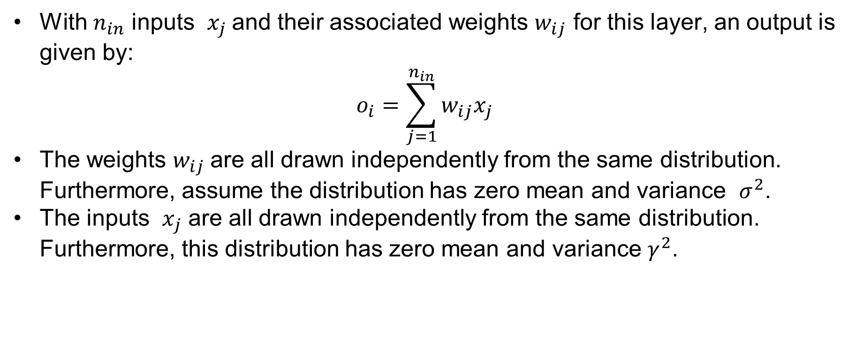
Xavier Initialization
With $n_{in}$ inputs $x_{j}$and their associated weights $w_{ij}$ for this layer, an output is given by:
$$o_{i}=\sum_{j=1}^{n_{in}}{w_{ij}x_{j}}$$
The weights $w_{ij}$are all drawn independently from the same distribution. Furthermore, assume the distribution has zero mean and variance $σ^{2}$.
The inputs $x_{j}$ are all drawn independently from the same distribution. Furthermore, this distribution has zero mean and variance $γ^{2}$.

Slide 9

Xavier Initialization
We can calculate the mean of output $o_{i}$ as follows:
$$E\left[o_{i}\right]= \sum_{j=1}^{n_{in}}{E\left[w_{ij}x_{j}\right]}=\sum_{j=1}^{n_{in}}{E\left[w_{ij}\right]E\left[x_{j}\right]}$$
$$E\left[o_{i}\right]= \sum_{j=1}^{n_{in}}{E\left[w_{ij}\right]E\left[x_{j}\right]}$$
$$E\left[o_{i}\right]= \sum_{j=1}^{n_{in}}{E\left[w_{ij}\right]E\left[x_{j}\right]}$$

Slide 10

Xavier Initialization
We can calculate the variance of output $o_{i}$ as follows:
$$Var\left[o_{i}\right]=E\left[o_{i}^{2}\right] −{\left(E\left[o_{i}\right]\right)}^{2}$$
$$Var\left[o_{i}\right]=\sum_{j=1}^{n_{in}}{E\left[w_{ij}^{2}x_{j}^{2}\right]−0}$$
$Var\left[o_{i}\right]=\sum_{j=1}^{n_{in}}{E\left[w_{ij}^{2}\right]E[x_{j}^{2}}$]
$$Var\left[o_{i}\right]=n_{in}σ^{2}γ^{2}$$

Slide 11
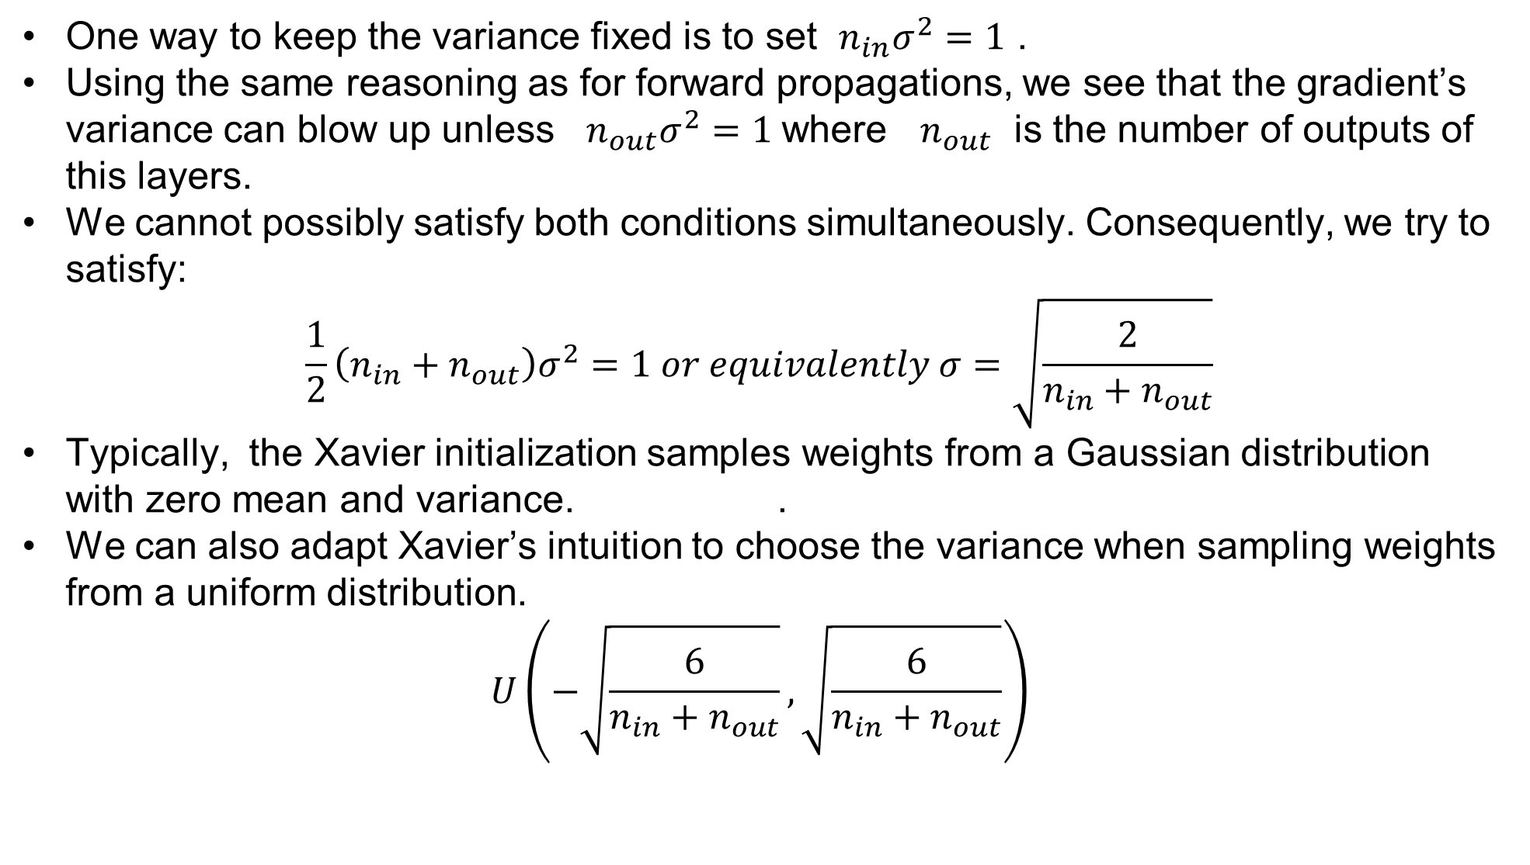
Xavier Initialization
One way to keep the variance fixed is to set $n_{in}σ^{2}=1$ .
Using the same reasoning as for forward propagations, we see that the gradient’s variance can blow up unless $n_{out}σ^{2}=1$where $n_{out}$ is the number of outputs of this layers.
We cannot possibly satisfy both conditions simultaneously. Consequently, we try to satisfy:
$$\frac{1}{2}\left(n_{in}+n_{out}\right)σ^{2}=1 or equivalently σ=\sqrt{\frac{2}{n_{in}+n_{out}}}$$
Typically, the Xavier initialization samples weights from a Gaussian distribution with zero mean and variance. .
We can also adapt Xavier’s intuition to choose the variance when sampling weights from a uniform distribution.
$$U\left(−\sqrt{\frac{6}{n_{in}+n_{out}}},\sqrt{\frac{6}{n_{in}+n_{out}}}\right)$$

Slide 12
References
https://d2l.ai/chapter_multilayer-perceptrons/numerical-stability-and-init.html

